Slide 1
Recap: maximum likelihood estimation
Data: a collection of words, $w_{1},w_{2},…,w_{n}$
Model: multinomial distribution $p(W)$ with parameters $θ_{i}=p\left(w_{i}\right)$, i.e., unigram language model
Maximum likelihood estimator: $\hat{θ}=argmax_{θ}p(W|θ)$
$$p\left(W | θ\right)=\left(\begin{matrix}N \\ c\left(w_{1}\right),…,c(w_{N})\end{matrix}\right)\prod_{i=1}^{N}{θ_{i}^{c(w_{i})}}∝\prod_{i=1}^{N}{θ_{i}^{c(w_{i})}}$$
$$\log{p\left(W | θ\right)}=\sum_{i=1}^{N}{c\left(w_{i}\right)\log{θ_{i}}}$$
$$L\left(W,θ\right)=\sum_{i=1}^{N}{c\left(w_{i}\right)\log{θ_{i}}}+λ\left(\sum_{i=1}^{N}{θ_{i}}−1\right)$$
Using Lagrange multiplier approach, we’ll tune $θ_{i}$ to maximize $L(W,θ)$
$$\frac{∂L}{∂θ_{i}}=\frac{c\left(w_{i}\right)}{θ_{i}}+λ → θ_{i}=−\frac{c\left(w_{i}\right)}{λ}$$
Set partial derivatives to zero
$$λ=−\sum_{i=1}^{N}{c\left(w_{i}\right)}$$
Since
$\sum_{i=1}^{N}{θ_{i}}$=1
we have
Requirement from probability
$$θ_{i}=\frac{c\left(w_{i}\right)}{\sum_{i=1}^{N}{c\left(w_{i}\right)}}$$
ML estimate

Slide 2
Recap: illustration of N-gram language model smoothing
$$p\left(w_{i} | w_{i−1},…,w_{i−n+1}\right)$$
Max. Likelihood Estimate
$$p\left(w_{i} | w_{i−1},…,w_{i−n+1}\right)=\frac{c(w_{i},w_{i−1},…,w_{i−n+1})}{c(w_{i−1},…,w_{i−n+1})}$$
Smoothed LM
w
Discount from the seen words
Assigning nonzero probabilities to the unseen words

Slide 3
Recap: perplexity
The inverse of the likelihood of the test set as assigned by the language model, normalized by the number of words
$$PP\left(w_{1},…,w_{N}\right)=\sqrt[N]{\frac{1}{\prod_{i=1}^{N}{p(w_{i}|w_{i−1},…,w_{i−n+1})}}}$$
N-gram language model

Slide 4
Latent Semantic Analysis
Hongning Wang
CS@UVa

Slide 5
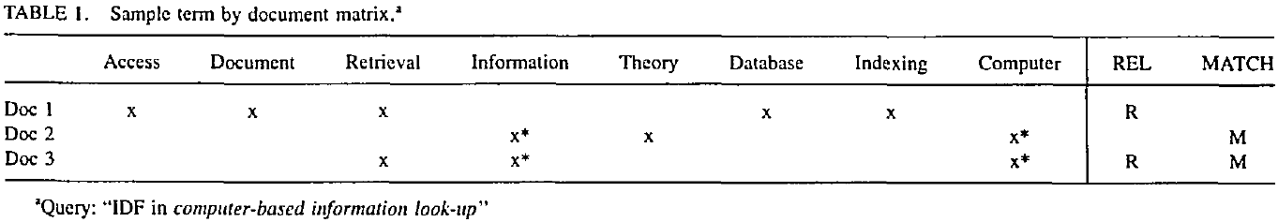
VS model in practice
Document and query are represented by term vectors
Terms are not necessarily orthogonal to each other
Synonymy: car v.s. automobile
Polysemy: fly (action v.s. insect)

Slide 6
Choosing basis for VS model
A concept space is preferred
Semantic gap will be bridged
Finance
D₂
D₄
D₃
Sports
Query
D₁
Education
D₅

Slide 7
How to build such a space
Automatic term expansion
Construction of thesaurus
WordNet
Clustering of words
Word sense disambiguation
Dictionary-based
Relation between a pair of words should be similar as in text and dictionary’s description
Explore word usage context

Slide 8
How to build such a space
Latent Semantic Analysis
Assumption: there is some underlying latent semantic structure in the data that is partially obscured by the randomness of word choice with respect to text generation
It means: the observed term-document association data is contaminated by random noise

Slide 9
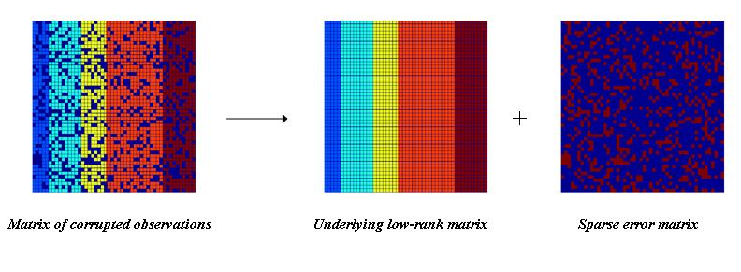
How to build such a space
Solution
Low rank matrix approximation
Imagine this is *true* concept-document matrix
Imagine this is our observed term-document matrix
Random noise over the word selection in each document

Slide 10
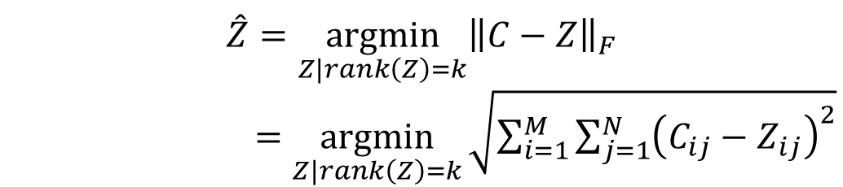
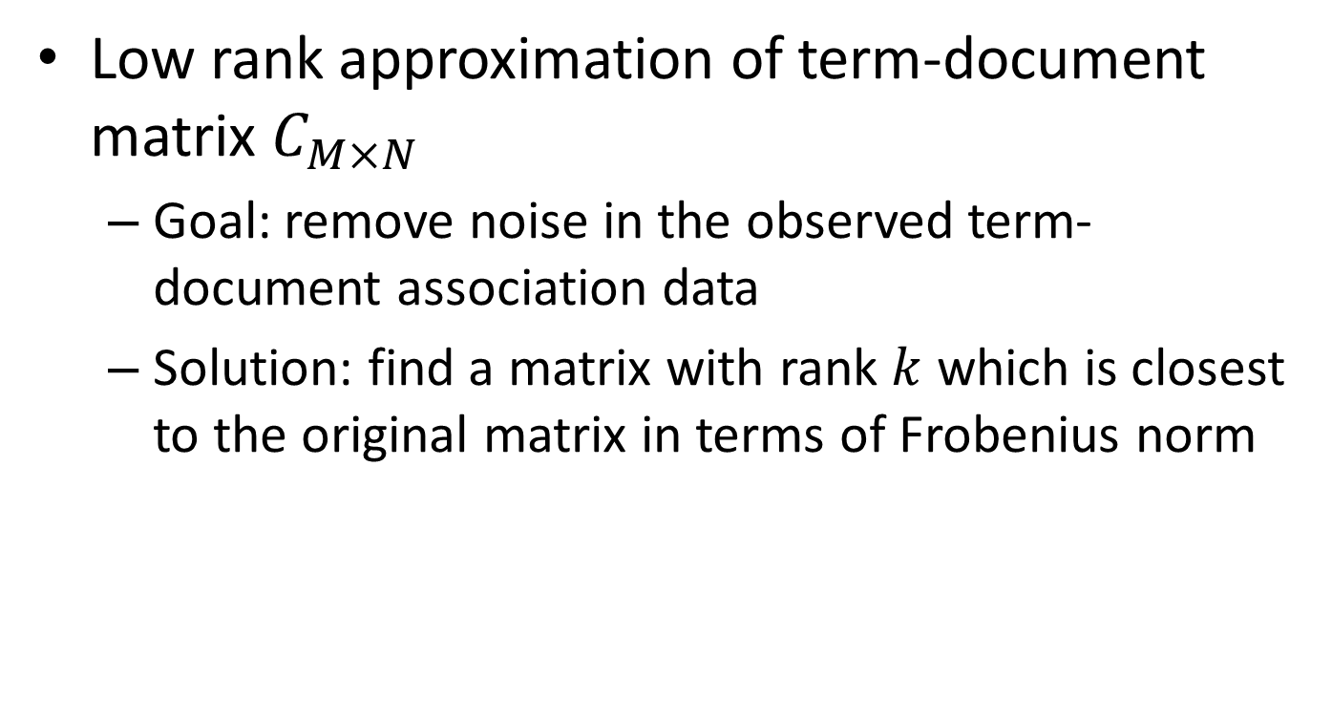
Latent Semantic Analysis (LSA)
Low rank approximation of term-document matrix $C_{M×N}$
Goal: remove noise in the observed term-document association data
Solution: find a matrix with rank $k$ which is closest to the original matrix in terms of Frobenius norm
$$\hat{Z}=\underset{Z|rank\left(Z\right)=k}{argmin}{{\left\|C−Z\right\|}_{F}}$$
$=\underset{Z|rank\left(Z\right)=k}{argmin}{\sqrt{\sum_{i=1}^{M}{\sum_{j=1}^{N}{{\left(C_{ij}−Z_{ij}\right)}^{2}}}}}$

Slide 11
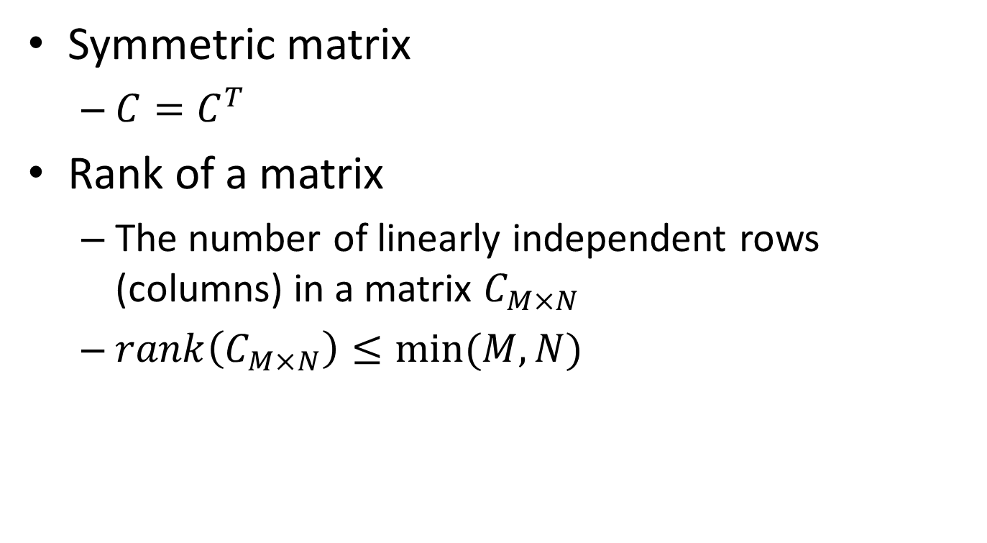
Basic concepts in linear algebra
Symmetric matrix
$C=C^{T}$
Rank of a matrix
The number of linearly independent rows (columns) in a matrix $C_{M×N}$
$rank\left(C_{M×N}\right)≤min⁡(M,N)$

Slide 12
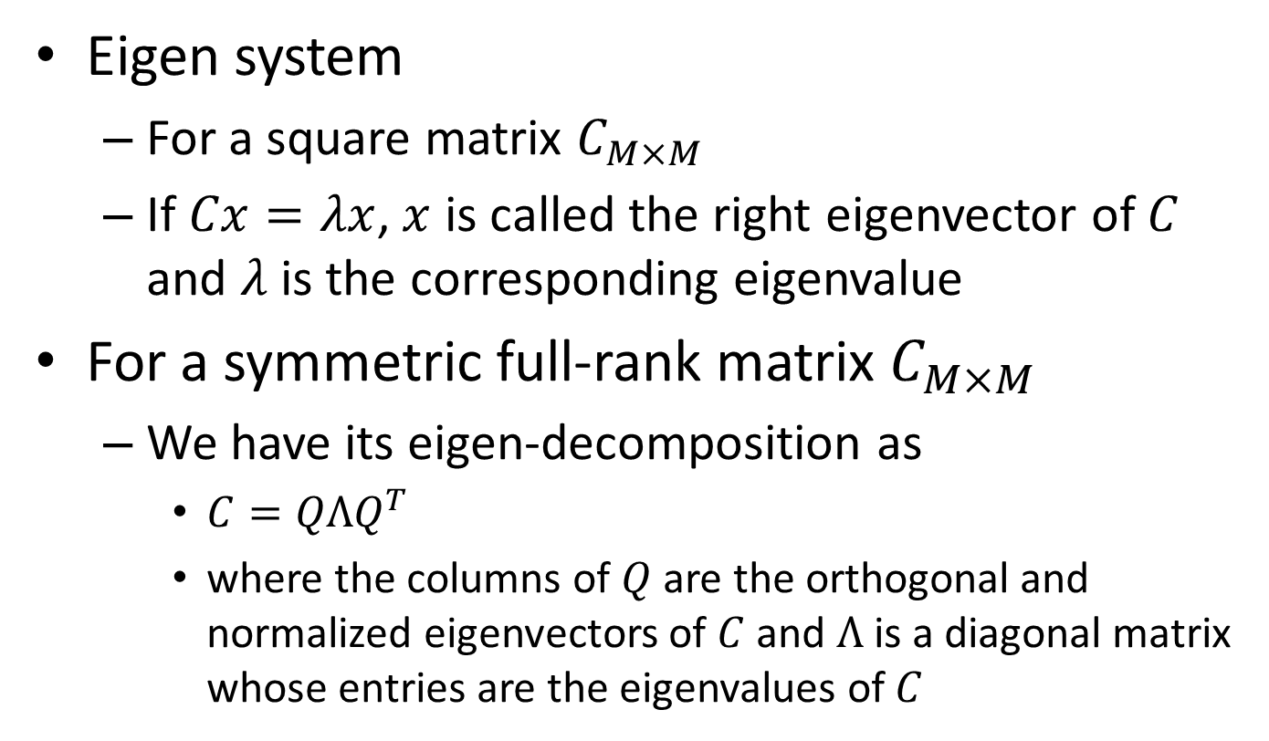
Basic concepts in linear algebra
Eigen system
For a square matrix $C_{M×M}$
If $Cx=λx$, $x$ is called the right eigenvector of $C$ and $λ$ is the corresponding eigenvalue
For a symmetric full-rank matrix $C_{M×M}$
We have its eigen-decomposition as
$C=QΛQ^{T}$
where the columns of $Q$ are the orthogonal and normalized eigenvectors of $C$ and $Λ$ is a diagonal matrix whose entries are the eigenvalues of $C$

Slide 13
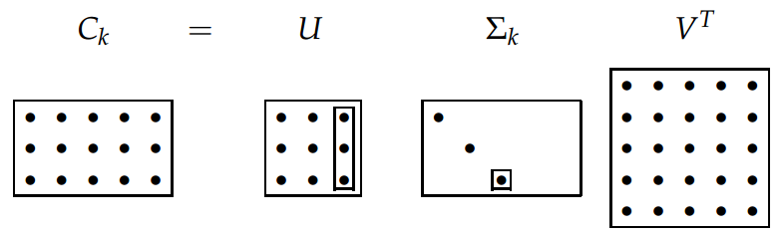

Basic concepts in linear algebra
Singular value decomposition (SVD)
For matrix $C_{M×N}$ with rank $r$, we have
$C=UΣV^{T}$
where $U_{M×r}$ and $V_{N×r}$ are orthogonal matrices, and $Σ$ is a $r×r$ diagonal matrix, with $Σ_{ii}=\sqrt{λ_{i}}$ and $λ_{1}…λ_{r}$ are the eigenvalues of $CC^{T}$
We define $C_{M×N}^{k}=U_{M×k}Σ_{k×k}V_{N×k}^{T}$
where we place $Σ_{ii}$ in a descending order and set $Σ_{ii}=\sqrt{λ_{i}}$ for $i≤k$, and $Σ_{ii}=0$ for $i>k$

Slide 14
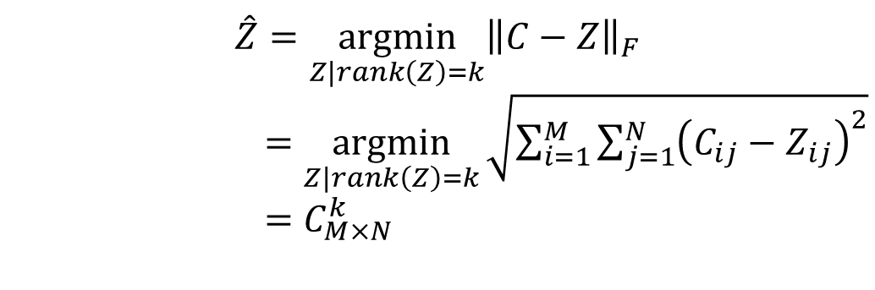

Latent Semantic Analysis (LSA)
Solve LSA by SVD
Procedure of LSA
Perform SVD on document-term adjacency matrix
Construct $C_{M×N}^{k}$ by only keeping the largest $k$ singular values in $Σ$ non-zero
Map to a lower dimensional space
$$\hat{Z}=\underset{Z|rank\left(Z\right)=k}{argmin}{{\left\|C−Z\right\|}_{F}}$$
$=\underset{Z|rank\left(Z\right)=k}{argmin}{\sqrt{\sum_{i=1}^{M}{\sum_{j=1}^{N}{{\left(C_{ij}−Z_{ij}\right)}^{2}}}}}$
$=C_{M×N}^{k}$

Slide 15

Latent Semantic Analysis (LSA)
Another interpretation
$C_{M×N}$ is the document-term adjacency matrix
${D_{M×M}=C}_{M×N}×C_{M×N}^{T}$
$D_{ij}$: document-document similarity by counting how many terms co-occur in $d_{i}$ and $d_{j}$
$D=\left(UΣV^{T}\right)×{\left(UΣV^{T}\right)}^{T}=UΣ^{2}U^{T}$
Eigen-decomposition of document-document similarity matrix
$d_{i}^{′}s$new representation is then ${\left(UΣ\right)}_{i}$ in this system(space)
In the lower dimensional space, we will only use the first $k$ elements in ${\left(UΣ\right)}_{i}$ to represent $d_{i}$
The same analysis applies to ${T_{N×N}=C}_{M×N}^{T}×C_{M×N}$

Slide 16
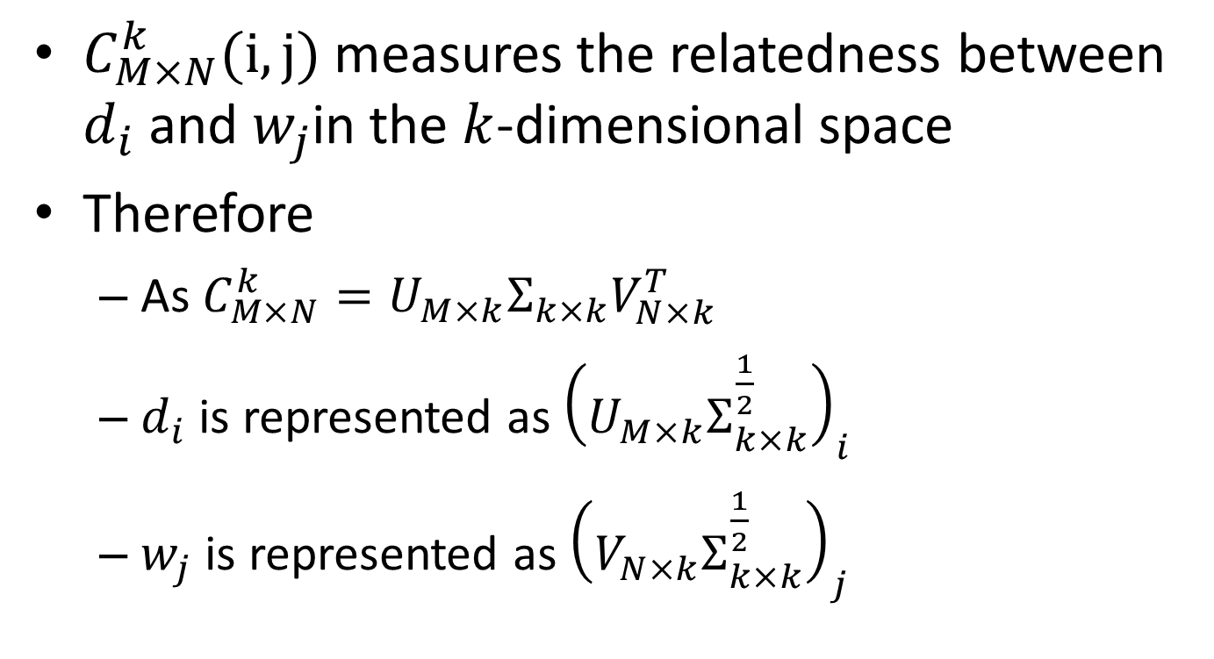
Geometric interpretation of LSA
$C_{M×N}^{k}(i,j)$ measures the relatedness between $d_{i}$ and $w_{j}$in the $k$-dimensional space
Therefore
As$C_{M×N}^{k}=U_{M×k}Σ_{k×k}V_{N×k}^{T}$
$d_{i}$ is represented as ${\left(U_{M×k}Σ_{k×k}^{\frac{1}{2}}\right)}_{i}$
$w_{j}$ is represented as ${\left(V_{N×k}Σ_{k×k}^{\frac{1}{2}}\right)}_{j}$

Slide 17
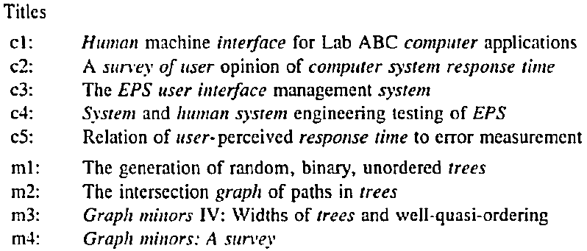
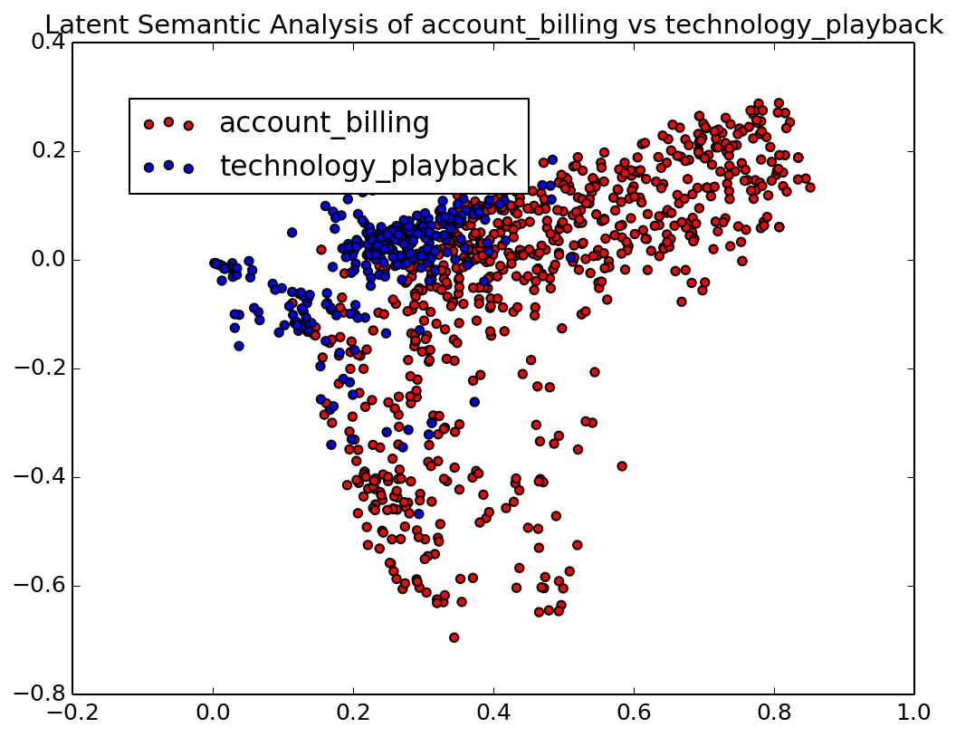
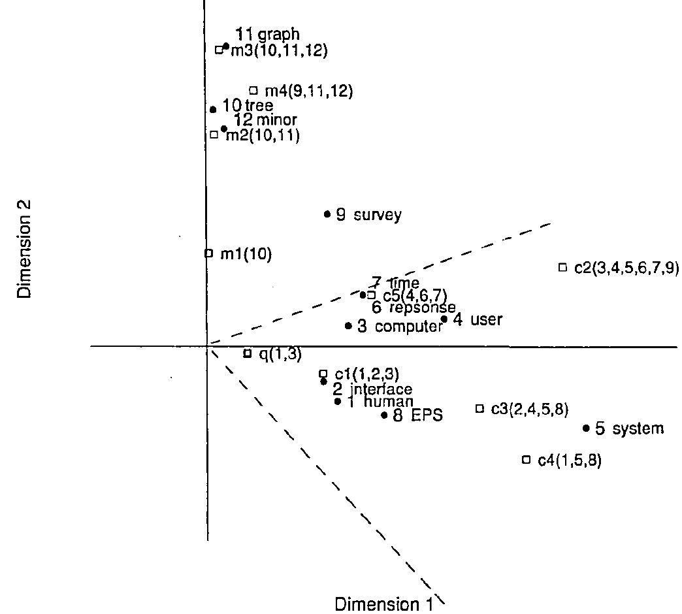
Latent Semantic Analysis (LSA)
HCI
Visualization
Graph theory

Slide 18
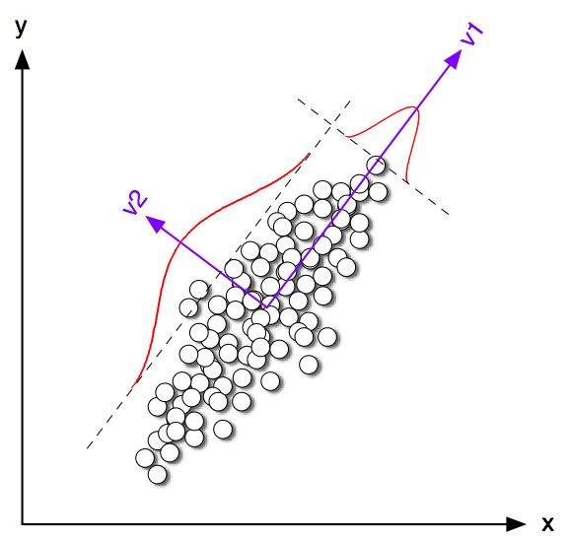
What are those dimensions in LSA
Principle component analysis

Slide 19
Latent Semantic Analysis (LSA)
What we have achieved via LSA
Terms/documents that are closely associated are placed near one another in this new space
Terms that do not occur in a document may still close to it, if that is consistent with the major patterns of association in the data
A good choice of concept space for VS model!

Slide 20
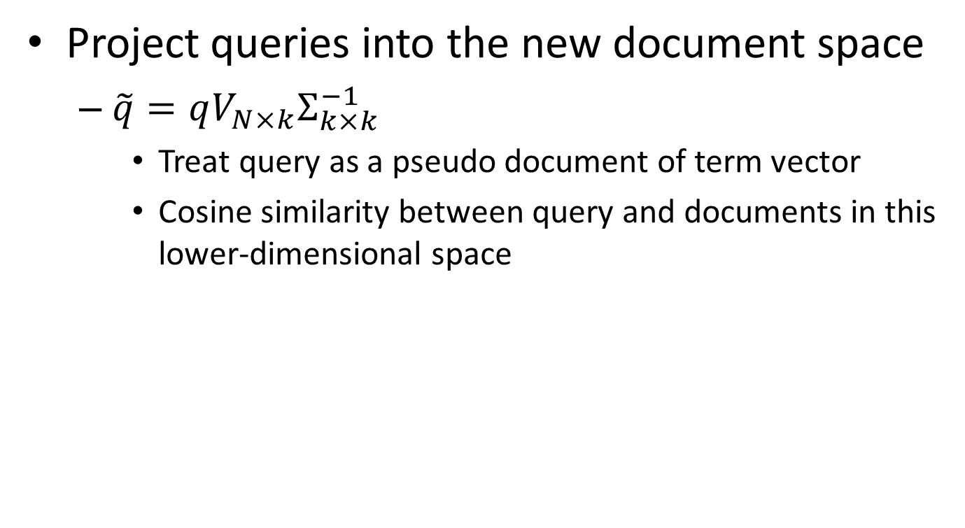
LSA for retrieval
Project queries into the new document space
$\tilde{q}=qV_{N×k}Σ_{k×k}^{−1}$
Treat query as a pseudo document of term vector
Cosine similarity between query and documents in this lower-dimensional space

Slide 21
LSA for retrieval
HCI
Graph theory
q: “human computer interaction”

Slide 22
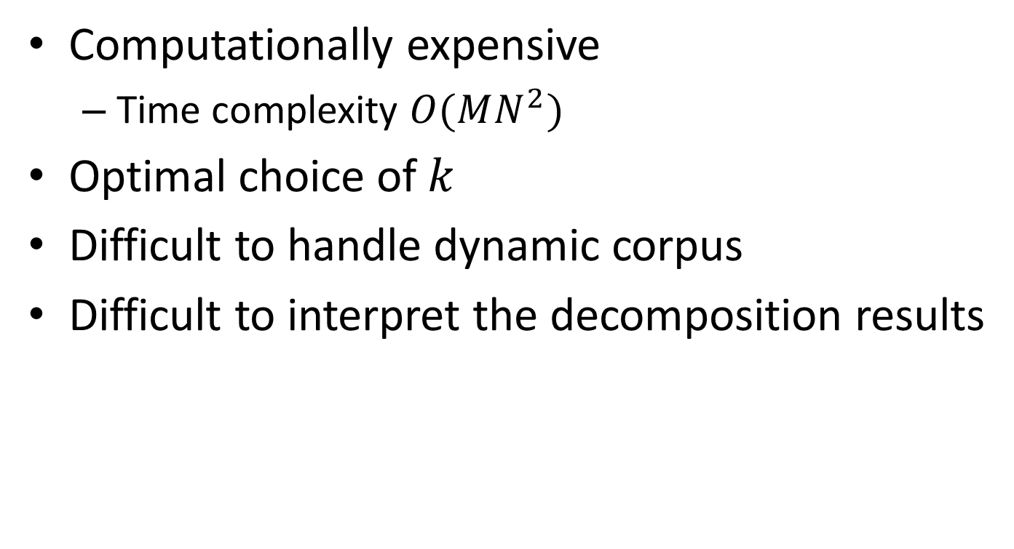
Discussions
Computationally expensive
Time complexity $O(MN^{2})$
Optimal choice of $k$
Difficult to handle dynamic corpus
Difficult to interpret the decomposition results
We will come back to this later!

Slide 23
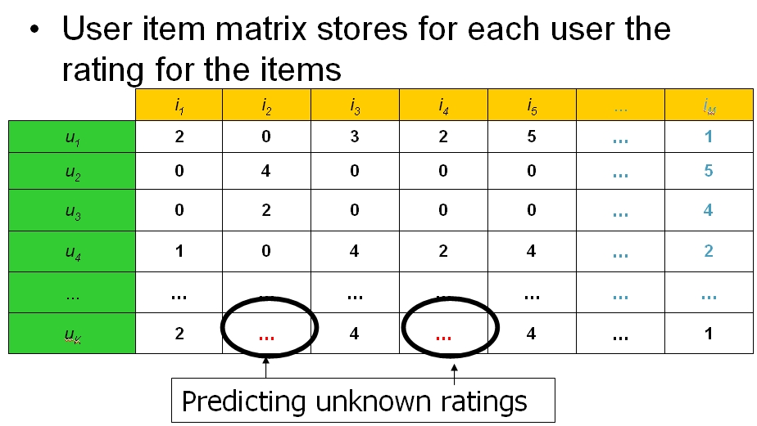
LSA beyond text
Collaborative filtering

Slide 24
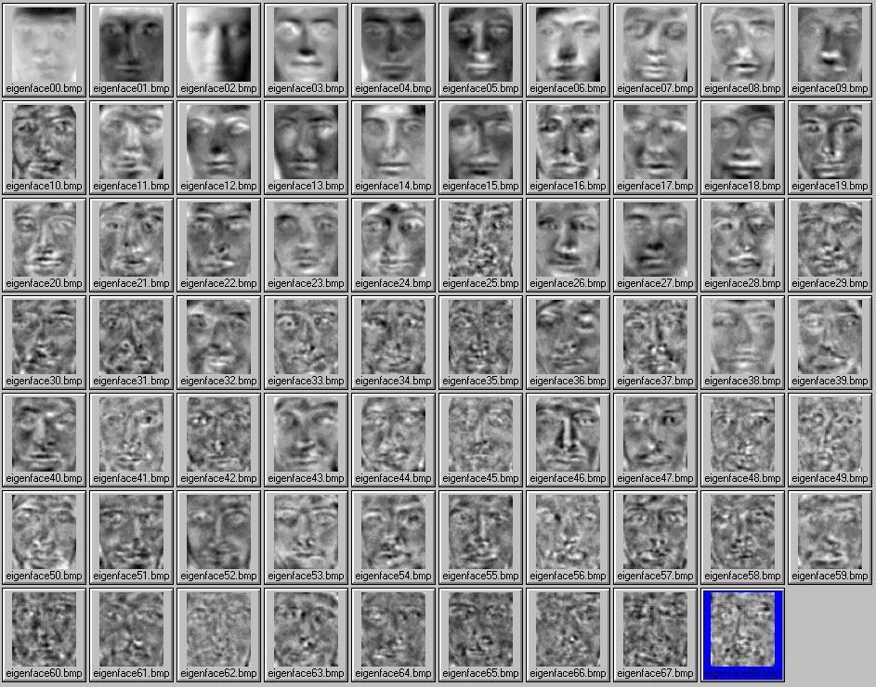
LSA beyond text
Eigen face

Slide 25
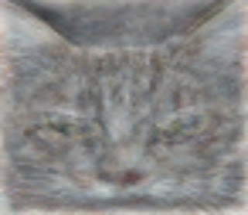
LSA beyond text
Cat from deep neuron network
One of the neurons in the artificial neural network, trained from still frames from unlabeled YouTube videos, learned to detect cats.

Slide 26
What you should know
Assumptions in LSA
Interpretation of LSA
Low rank matrix approximation
Eigen-decomposition of co-occurrence matrix for documents and terms

Slide 27
Today’s reading
Introduction to information retrieval
Chapter 13: Matrix decompositions and latent semantic indexing
Deerwester, Scott C., et al. "Indexing by latent semantic analysis." JAsIs 41.6 (1990): 391-407.

Slide 28
Happy Lunar New Year!

